Slide 1
Educational Performance prediction by using Linear Regressions
California (U.S.A)

Slide 2
Variables insight table
NAME | Label
acs_46 | Average class size class size grades 4-6
acs_k3 | Average class size kg-3
api00 | Academic Performance Indicator 2000
api99 | Academic Performance Indicator 1999
avg_ed | Average number of Years of High school parent education
col_grad | % of Parents who are college grad
dnum | district number
ell | % of Students who are English language learners
emer | % of part Time Teachers
enroll | Number of students
full | % of full Time Teachers
grad_sch | % of Parents who are attended grad school
growth | growth 1999 to 2000
hsg | % of Parents who are high school graduate
mealcat | free meals in 3 categories
meals | % of Students who opt for free meals
mobility | Dropout Rate
not_hsg | % of Parents who are not high school graduate
snum | school number
some_col | % of Parents who are attended some college
yr_rnd | year round school – School open through the year or not

Slide 3
By examining the the variables using PROC CONTENTS feature in SAS We get to know that all
variables are in numerical format even the two variables named:
1. Mealcat (meals category divided in to 3 parts)
2. Year round school ( divided in to 2 categories )
are categorical in nature and may have a high influence over other variables
We found out some anomalies in the data usig Proc Univariate feature of SAS listed below:
Growth variable consist some –ive values , our assumption is that this variable is in %age form and
cant be in –values that has to be made positive.
Percentage free meal consisted 85 missing values that is to be replaced by the respective mean of
three categories in Mealcat variable.
Pct 1 yr in school , acs_k3, acs_46 , mobility consisted some missing value that’s to be replaced by
mean.
Avg parent edu contained 19 missing values to be replaced by zero as there is sound possibility that
there might be some parents who are not educated at all.
Values which are less than 1 in full time teacher came out 19 values are to be converted in to
percentages.

Slide 4
Here the correlation of Api2000 is shown with the other variables

Slide 5
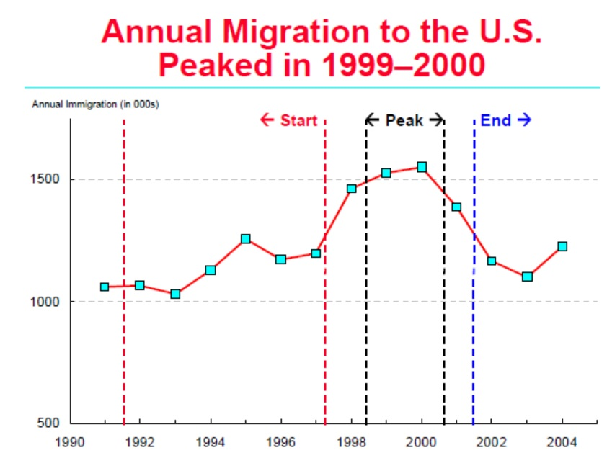
Iterations on significantly correlated variables:
MEALS + Yr_rnd:
The negative correlation of Variable Meals is 0.88 which signifies that when more free meals opting
Students are there in schools the academic performance goes down at high rate, it can be due
to following reasons:
More free meals opting students means more poor students who may come to school just for
The sake of meals, they don’t have proper resources to study well .
A strong possibility is there that this population of free meal opters contributes to full time
schools which is also negatively co-related .
ELL:
Refers to English language learners .
Since the medium of education in USA is mostly
English, there are high possibilities that the students
who don’t know English well cant perform good in studies.
Also year 1999-2000 was recorded as the year when the immigration was at peak in USA, mostly from Vietnam which is a under developed nation.
Overview BY JEFFREY S. PASSEL AND ROBERTO SURO http://www.pewhispanic.org

Slide 6
Yr_rnd + Full (Full time teachers) + emmer (part time teachers
The –ive correlation in this variable indicated that Year Round Schools gives less academic performance than those of part time schools, reason can be :
Free meal opting students who like to come school daily, but cant afford to study well.
%age of full time dedicated teachers is less in year round schools.
May be because of extreme weather conditions good students prefer to study from home.
checking year round schools with full time teachers
year round school | N Obs | Variable | Label | Mean
0 | 308 | api00 | api 2000 | 684.539
 |  | full | %age of full time teachers | 87.79545
1 | 92 | api00 | api 2000 | 524.0326
 |  | full | %age of full time teachers | 73.68478
Not_hsg
Parents who are not high school graduates
obviously cant treach their children well, leading
to –ive correlation and lowering the
academic performance.

Slide 7
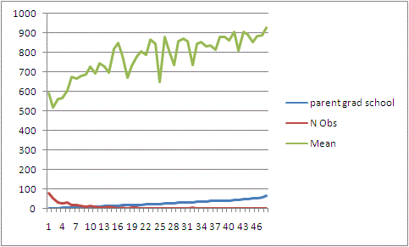
Some_coll, coll_grad, Grad_sch, avg_edu
Since there is +ive correlation between these variables ,all these education factor of parents indicates that more the parents are educated , better the academic performance kids deliver in education.
End of Iterations

Slide 8
First Regression model
Now from here onwards we
eliminated the variables one by one
till we achieved a model With :
VIF not more than 1.7
P-statistics less than 95% of
confidence level
P-val <0.0001
Rsq 0.8491
AdjRsq 0.8428
Rsq , Adj Rsq we got here in 1st model significantly ok
but difference in Rsq and Adj Rsq indicates the presence of
irrelevant variables.
Here first we have to remove Avg_Edu variable because of high VIF.

Slide 9
Here we see high variance in variables
Meals & Mealcat which are to be removed
Sequentially because of high VIF.
When we see this high multi collinearity,
to take the decision of which variable
is to be removed so that variance get reduce
of other variables , we refer to
Collinearity Diagnostics table
meals | ell | yr_rnd | mobility | acs_k3 | acs_46 | not_hsg | hsg | some_col | col_grad | grad_sch | full | emer | enroll | mealcat
0.00 | 0.00 | 0.00 | 0.01 | 0.00 | 0.00 | 0.07 | 0.37 | 0.51 | 0.06 | 0.01 | 0.00 | 0.01 | 0.00 | 0.00
0.00 | 0.09 | 0.00 | 0.38 | 0.00 | 0.00 | 0.00 | 0.06 | 0.18 | 0.08 | 0.00 | 0.00 | 0.00 | 0.05 | 0.00
0.00 | 0.21 | 0.04 | 0.00 | 0.00 | 0.00 | 0.54 | 0.09 | 0.01 | 0.15 | 0.02 | 0.00 | 0.02 | 0.20 | 0.00
0.01 | 0.04 | 0.21 | 0.13 | 0.00 | 0.00 | 0.19 | 0.04 | 0.00 | 0.00 | 0.04 | 0.00 | 0.01 | 0.49 | 0.01
0.00 | 0.03 | 0.07 | 0.19 | 0.01 | 0.03 | 0.05 | 0.16 | 0.17 | 0.15 | 0.21 | 0.01 | 0.02 | 0.11 | 0.00
0.06 | 0.54 | 0.00 | 0.23 | 0.00 | 0.00 | 0.01 | 0.06 | 0.00 | 0.00 | 0.00 | 0.00 | 0.02 | 0.11 | 0.06
0.03 | 0.01 | 0.00 | 0.01 | 0.01 | 0.80 | 0.00 | 0.00 | 0.01 | 0.00 | 0.00 | 0.08 | 0.07 | 0.00 | 0.00
0.89 | 0.02 | 0.01 | 0.00 | 0.01 | 0.05 | 0.00 | 0.00 | 0.00 | 0.00 | 0.01 | 0.00 | 0.00 | 0.00 | 0.90
We remove the variable which has more
value here which is MealCat having
value of 0.90
same kind of Treatment is to be
done with rest of the variables
till we achieve a perfect model.

Slide 10

Finally Achieving the final model where all variances
Are below than 1.7 and P-values below 0.05
Rsq = 0.80
Adj Rsq = 0.80
ChaiSq = 0.097
Mean Error = 8.25 (abs)
Rsq derived here means the model is excellent and 80%
Of the variations in independent variables can be
explained by our model.
Secondly high ChaiSq here indicates that there is
Significantly Low problem of multi collinearity in our model
With max possibility of error = 8.25
Since from the starting we have found that Meal is the most important variable which is influencing
the academic performance on large scale, we tried to keep it in our model till the end and keep other
Correlated variables keeps on eliminated till we achieve VIF of MEAL = 1.69.
Meal was the important factor from the starting, and when we tried to remove it to see the impact , we noticed that Rsq dropped out significantly , which obviously we don want to maintain the predictive power
of our model.

Slide 11
Line graph for Api00 & Predicted Performance
We can see here that our predicted performance is in total sync with the variable Api00
Thus proving our model fit and Sound.

Slide 12
Thank You.

